Slide 1
RNDPS v2: Customizing the Mojaloop Switch for Instant Payments
Reconciliation & Dispute

Slide 2
Reconciliation: Introduction
The primary goal of this reconciliation module is to ensure that DFSPs (Digital Financial Services Providers) and the switch agree on settlement outcomes, emphasizing fairness.

Slide 3
Settlement and Reconciliation Windows/Cycles
Settlement/Reconciliation Structure: Settlements and reconciliations are organized into time-bound windows, each containing a set of transactions.
Window Timeline: Each settlement window has defined start and transition times, setting the period during which the DFSPs' transactions must have occurred. DFSPs can upload their files at a later date, but the uploaded file must include only the transactions that happened within the specific settlement window.

Slide 4
Reconciliation Slots for DFSPs
Slot Creation: For every settlement window, each DFSP is assigned a reconciliation slot.
Pending Reconciliations: Each slot starts with a pending status, prompting DFSPs to upload transactions that cleared on their end during the specific window timeframe.

Slide 5
Comparison Process
System Comparison: Once transactions are uploaded by the DFSPs, the system automatically compares them to the switch’s records.
The main goal is to confirm that both DFSPs and the switch have a shared view of the settlement, ensuring it aligns with expectations of fairness.
Objective

Slide 6
Types of Mismatches Identified
Missing Transactions in DFSP records
Transactions that appear on the switch but are missing from the DFSP’s records.
Extra Transactions in DFSP records
Transactions found in the DFSP’s records that are not reflected on the switch.
Amount Mismatch
Transactions that are present in both records but with differing transaction amounts.
All switch transactions
Additionally, We list of all transactions records from this settlement cycle/window for the participant in question as is on the switch to facilitate manual processes when necessary.

Slide 7
Reconciliation Process
Settlement
Reconciliation
Participant (DFSP)
Settlement cycle period done
Through The FTP server
File Upload in the portal
The system automatically closes the cycle
Group all successful & Cleared transactions per Participant
Provide data for ekash transactions in that specific cycle
Records matching and grouping the outcome
Transactions available in switch only
Transactions available in DFSP only
Transactions in both with different amounts
Transactions That are matching

Slide 8
Benefits of the Reconciliation Module
Fairness Verification
Helps confirm that DFSPs and the switch have a mutual understanding of the settlement’s fairness.
Provides clear insights into any mismatches, facilitating efficient resolution of discrepancies.
Automates the mismatch identification process, reducing the need for manual reconciliation efforts.
Transparency and Resolution
Efficiency

Slide 9
Dispute: Introduction
To facilitate structured dispute resolution, ensuring fairness and transparency between DFSPs, the switch, and, if necessary, the dispute decision panel.

Slide 10
Types of Disputes
Transaction based Disputes
Linked to specific transactions.
General issues not linked to specific transactions, where the DFSP can select the receiving party (another DFSP or the switch itself).
Non-Transaction based Disputes

Slide 11
Dispute Process
Initiator (DFSP)
Respondent (DFSP)
Switch
Initiate dispute
Review the dispute
Through reconciliation
Dispute manual creation
Transa-ction based
Decline
Approve
Settle the Transaction if necessary
Automatically Share It with the participant involved in the transaction
Manually choose the participant to assign it to

Slide 12
Dispute Process
Initiator (DFSP)
Respondent (DFSP)
Switch
Review the response
Review the dispute
Review the dispute
Escalate
Close
Decline
Approve
Escalate to dispute decision panel
Make a decision and close the dispute
Receive the escalation response

Slide 13

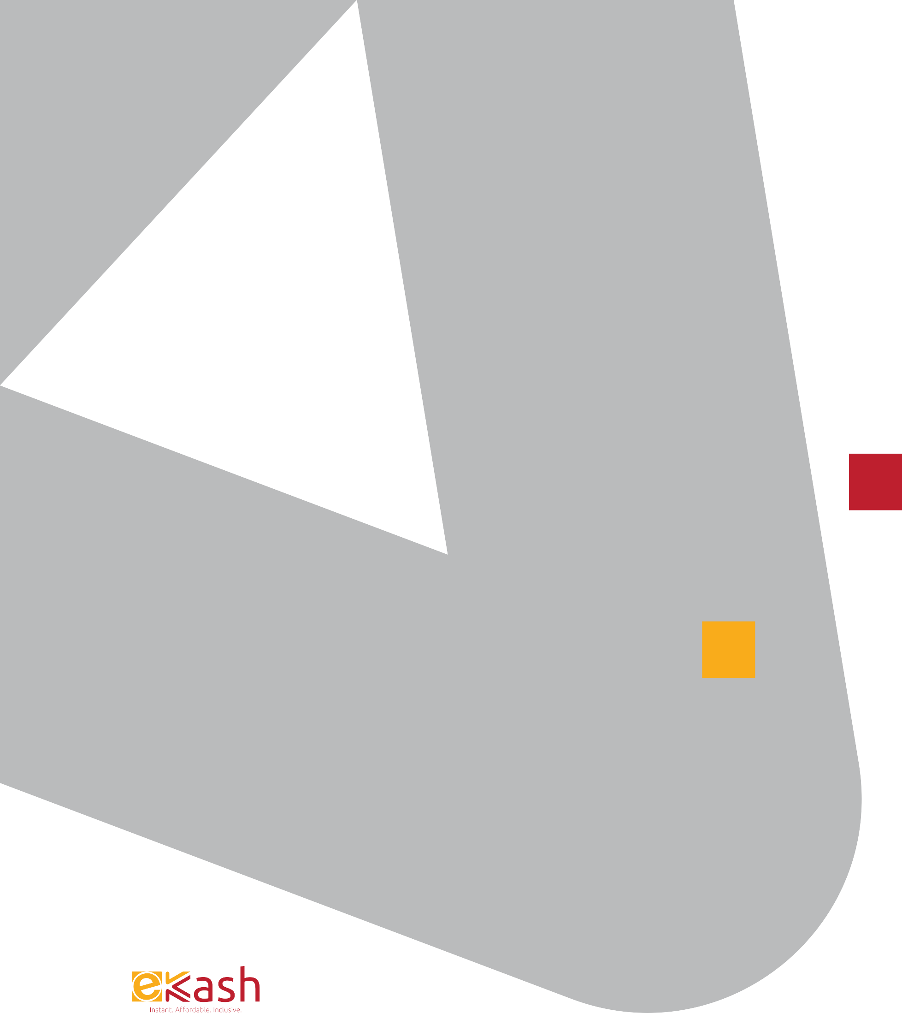
End.
Thank You.
Demo

Slide 14
End.
Thank You.

